Slide 1
Marshall Fire
Church
Care Training

Slide 2
Our Goals
Self
God
Others
Creation
Our Goals
Connection back to a church and relationship with God
Meet immediate and long- term holistic needs
We use meeting tangible needs to invite people into relationship with God and the Church
Gospel creates true lasting change and meets our deepest needs, reconciliation is our first mission

Slide 3
National Partners
SERVE 6.8
Church A
Lead 1
Lead 2
Church B
Lead 1
Helps provide resources, strategy and consolidated efforts to care for families
Families are connected to a church based on relationship or needs
Church lead oversees members caring for families, communicates back to 6.8, provides feedback and access to church resources
Member communicates with impacted family and holds relationships
Member
Member
Member
Member

Slide 4
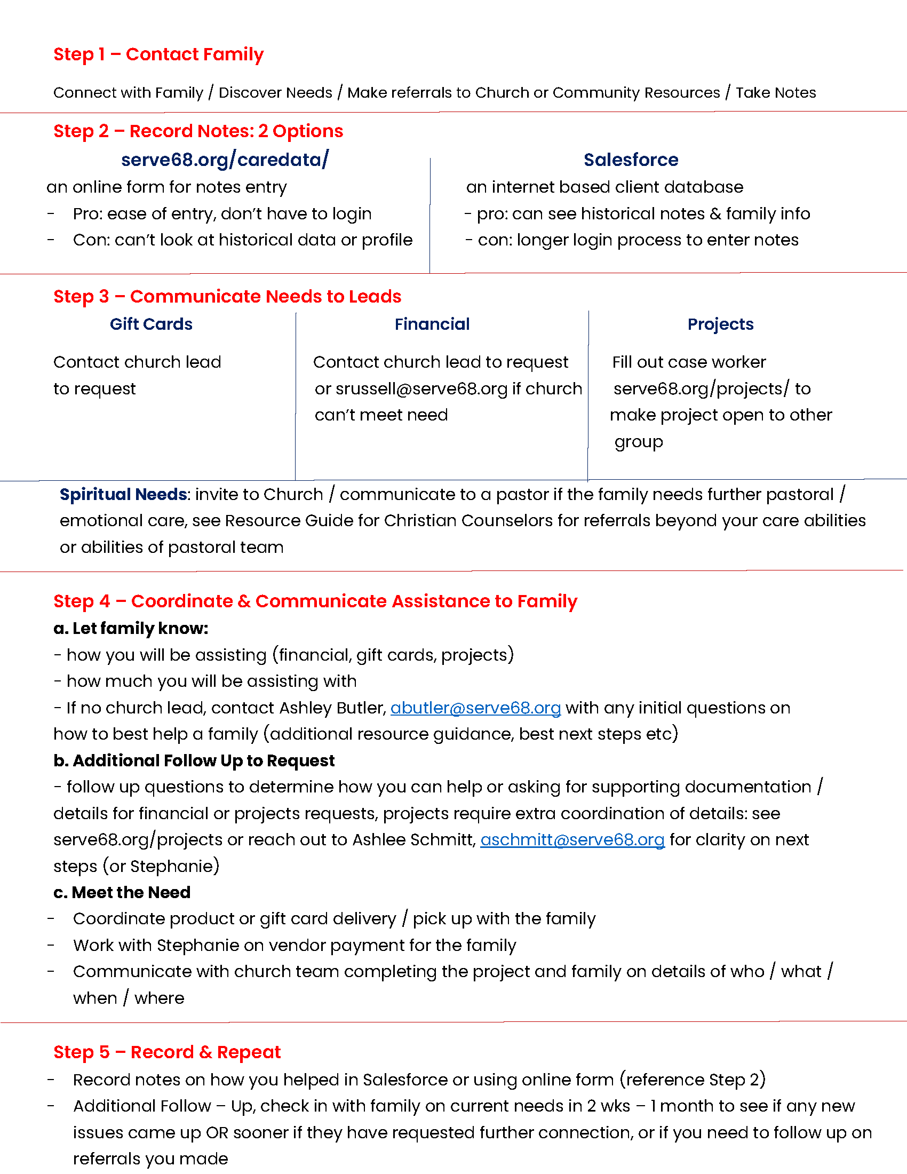
The Process – Big Picture

Slide 5
1st Interview / Call
First Interview
Checking on any current church connectivity or interest
Ask about other social supports
Family information: size, ages, household makeup
assessing current FEMA/Insurance/SBA Loan/Financial Picture
current employment, income lost, if they took time off
looking at emotions: anxiety, guilt, fear etc.
Identify short and long-term goals & needs
Ask if they have plans to rebuild or relocation – where are they now and where do they want to be
Ask if they are open to you closing the call in prayer
Review of 1st Assessment & Online Pre-Assessment Form (may need to fill out some of this)
Initial Assessment.docx - Google Docs

Slide 6
After the 1st Interview
Review case with team leader about any tangible needs or additional resources needed
No team lead, contact Ashley Butler at abutler@serve68.org
Put notes into database
Communicate with family about how you can support them, details to make it happen
Communicate with church team if you need help providing items to family
Provide vendor details for any Check Requests to submit to SERVE 6.8
Gifts Cards from church or SERVE 6.8 (egift cards)
Provide invite to church or new believers class, etc
SERVE 6.8 can also help connect families to project work or your church can put together move teams etc, connect with Ashlee Schmitt, aschmitt@serve68.org for project needs

Slide 7
Interview Skills
Listening to Story vs Waiting to Respond
You don’t need to ask questions in order or as a question list, be conversational
Consider writing questions downs to come back to later as you listen
Be with people in their suffering, it’s okay to a take few moments to be present
People’s Earthly Story leads to God’s Eternal Story
Scripture usage: narrative passages > singular verses (add exploration and explanation)
Use open ended questions and don’t be afraid to ask clarifying questions

Slide 8
Resources & Database
Resource Guide
Review of Salesforce (if applicable)
Front End Entry Form

Slide 9
Family Assignments
Start with 1-3 families
Anticipate every family you connect with to be approximately 1-3 hours for your first week or two
1 hour for future follows ups
Family lists from Samaritans Purse or you can connect with families you already know
NoCo Fire Response - SERVE 6.8 (serve68.org)

