Slide 1
Faith Church
Neighboring in Action

Slide 2
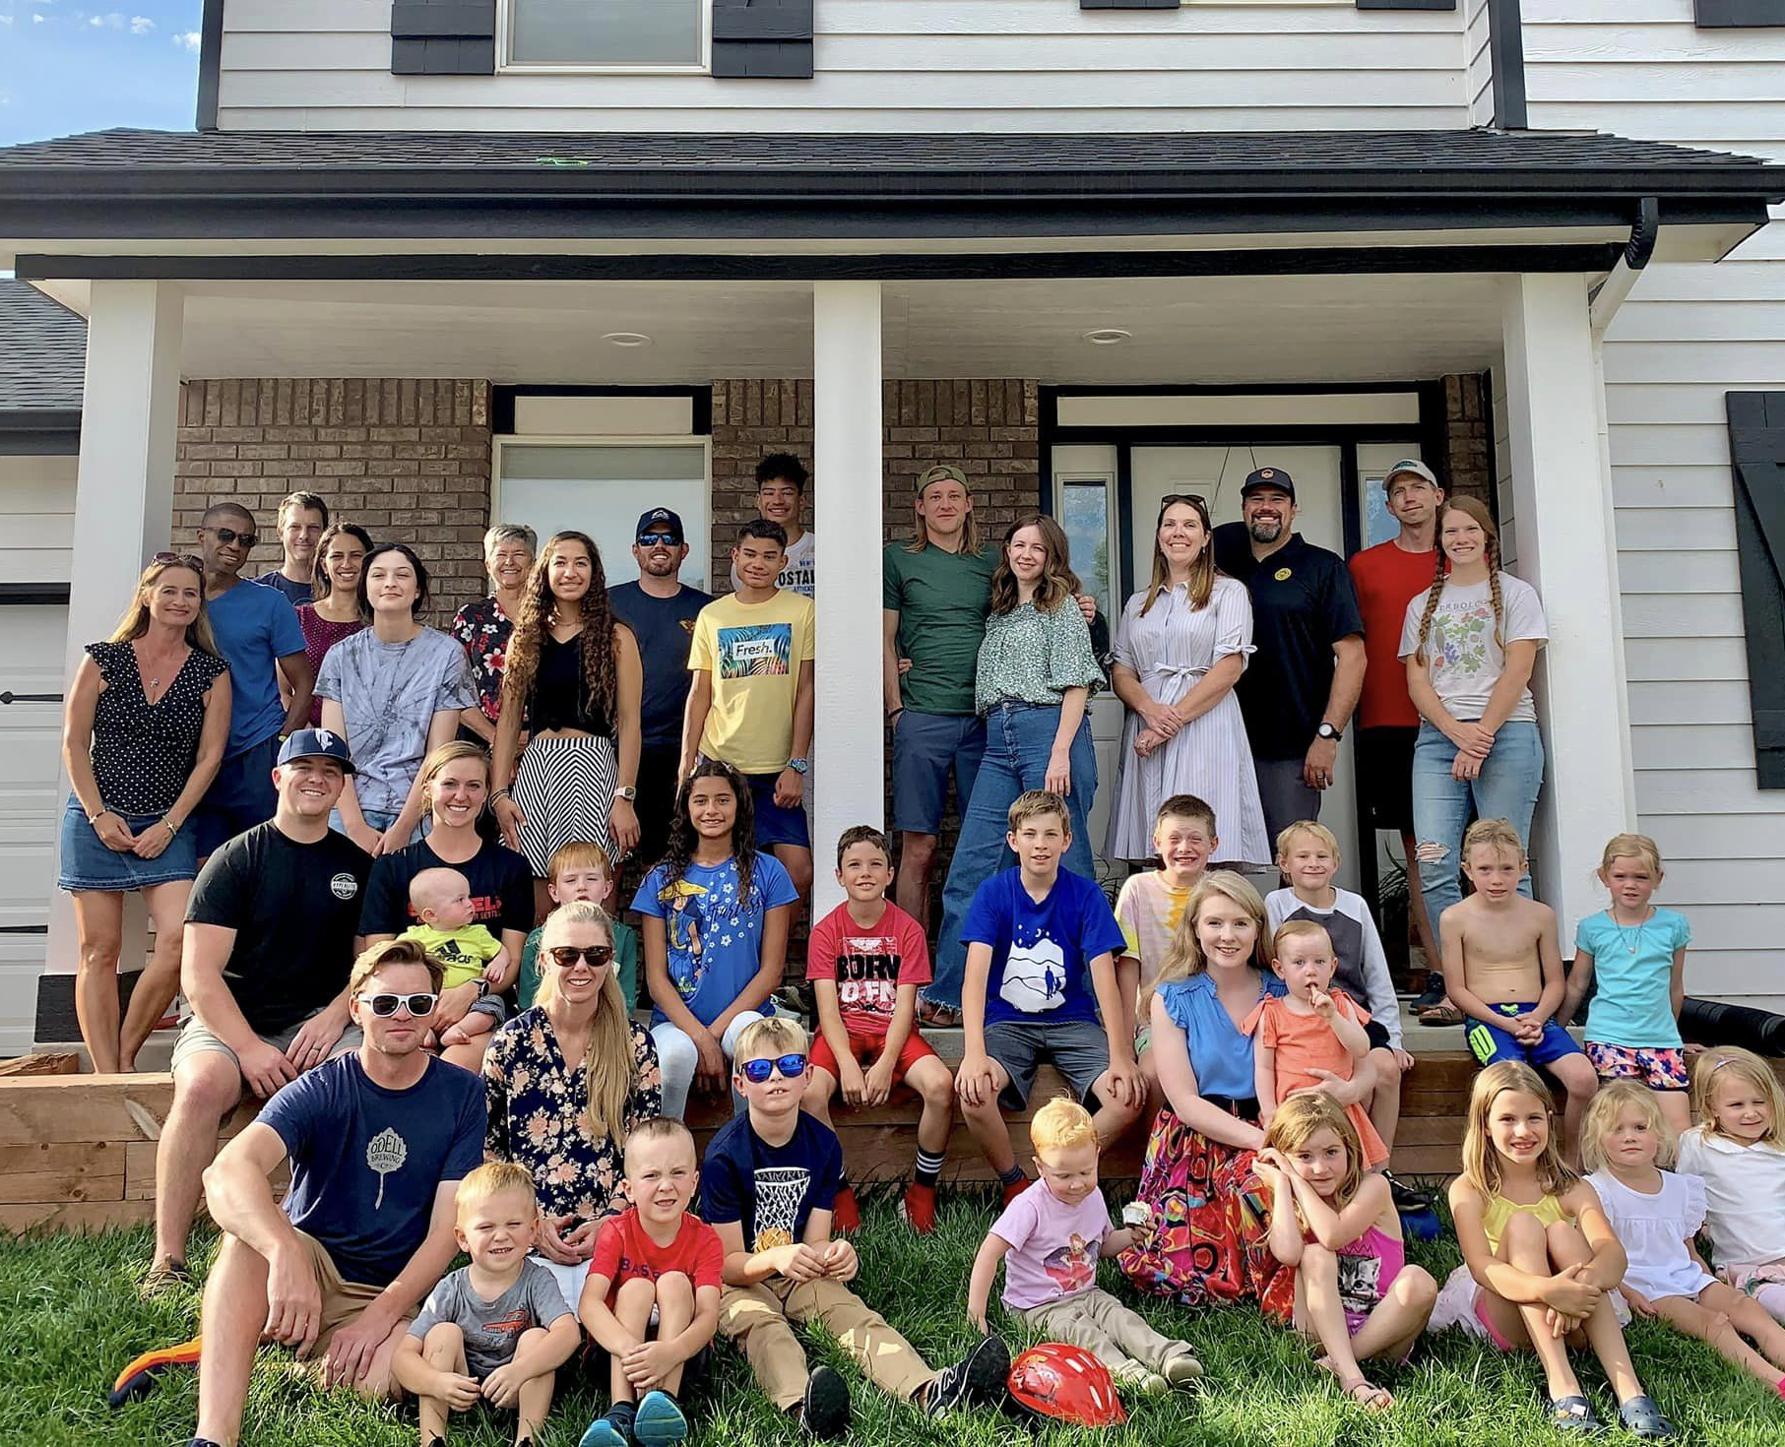
Personal Journey of Neighboring Summit Squad
Where the passion comes from and how it stays
How neighboring started on our cul-de-sac
How it’s going now
Focus on relationships you can build on; keep reaching out
Areas to grow in

Slide 3
Review of Neighboring Top things I’ve learned
How we view people matters; individual and eternal creations of God
Stories not Stereotypes
Busyness & Priorities, make the time
Neighboring pushes us out of our comfort zone
You may not have a gift, but you can have a value
Use your talents well & let other’s use theirs to build reciprocal community, relationships aren’t one sided
Small things make a big difference for people, check in and remember details
Relationships mean conflict. – listening well doesn’t equal always affirming
Relationships take work and effort to start and maintain
Notes:
“We can lay down some general principles, but there can be no automatic application. If we are truly personal, as created by God, then each individual will differ from everyone else. Therefore, each person must be dealt with as an individual, not a case or statistic or machine. If we would work with these people, we cannot apply the things we have dealt with in this book mechanically. We must look to the Lord in prayer and to the work of the Holy Spirit, for the effective use of these things”. Francis Shaeffer, the God Who is There
“It is a serious thing to live in a society of possible gods and goddesses, to remember that the dullest most uninteresting person you can talk to may one day be a creature which,if you saw it now, you would be strongly tempted to worship, or else a horror and a corruption such as you now meet, if at all, only in a nightmare. All day long we are, in some degree helping each other to one or the other of these destinations. It is in the light of these overwhelming possibilities, it is with the awe and the circumspection proper to them, that we should conduct all of our dealings with one another, all friendships, all loves, all play, all politics. There are no ordinary people. You have never talked to a mere mortal. Nations, cultures, arts, civilizations - these are mortal, and their life is to ours as the life of a gnat. But it is immortals whom we joke with, work with, marry, snub, and exploit - immortal horrors or everlasting splendors.”
¹⁶ So from now on we regard no one from a worldly point of view. Though we once regarded Christ in this way, we do so no longer. ¹⁷ Therefore, if anyone is in Christ, the new creation has come:^{[a]} The old has gone, the new is here! ¹⁸ All this is from God, who reconciled us to himself through Christ and gave us the ministry of reconciliation: ¹⁹ that God was reconciling the world to himself in Christ, not counting people’s sins against them. And he has committed to us the message of reconciliation. ²⁰ We are therefore Christ’s ambassadors, as though God were making his appeal through us. We implore you on Christ’s behalf: Be reconciled to God. 2 Corinthians 5:16-20

Slide 4
Prayer & Scripture in Care
Evangelism vs Discipleship > our responses will change based on a person’s relationships with God
Scripture doesn’t have to be used as a quick fix to people’s problems
We can use Scripture to point back to truths and provide direction to other’s lives
We can use Scripture passages to help people see how truths can apply to their lives and see how the Bible relates to what they are going through
Prayer is one of the easiest ways to start sharing Scriptural truths with believers and nonbelievers (don’t forget the power of intercessory prayer)
Notes:
“Is it not amazing: though we know the power of the Holy Spirit can be ours, we still ape the world’s wisdom, trust its forms of publicity and its noise, and imitate its ways of manipulating men! If we try to influence the world by using its methods, we are doing the Lord’s work in the flesh. If we put activity, even good activity, at the center rather than trusting God, then there may be the power of the world, but we will lack the power of the Holy Spirit. The key question is this: As we work for God in this fallen world, what are we trusting in? To trust in particular methods is to copy the world and to remove ourselves from the tremendous promise that we have something different—the power of the Holy Spirit rather than the power of human technique.” Francis A. Schaeffer, No Little People

Slide 5
Neighboring examples and strategy
Community potlucks
Neighborhood easter egg hunt
Deliver holiday treat baskets
Sports watching parties
Offer to rake leaves or shovel someone else’s driveway
Go on neighborhood walks (and invite someone to go with)
Neighborhood movie night
Birthday porch parties
Share garden vegetables
Offer to start a neighborhood text group or get contact information from neighbors
Offer to help with yard work or pet sitting

Slide 6
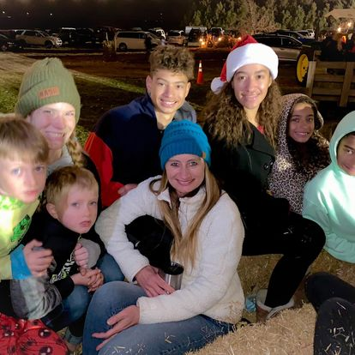
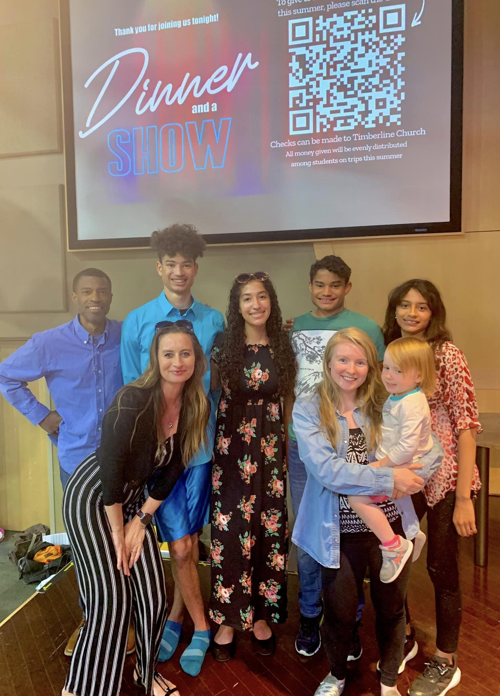
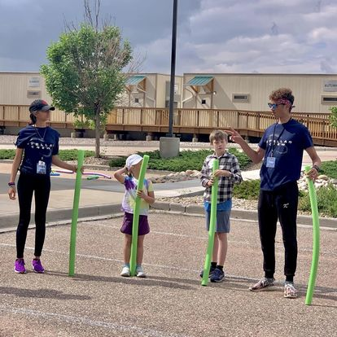
Church Events & Connections
Building up a relationship brought new families to church connection and discipleship opportunities

Slide 7
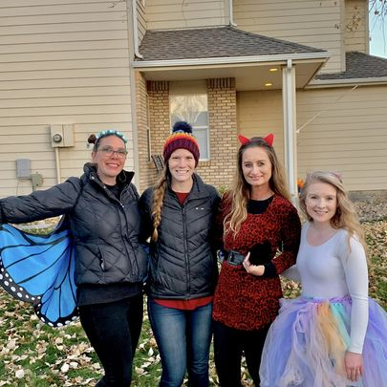
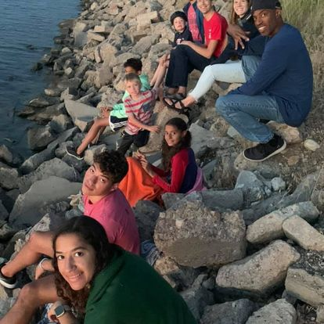
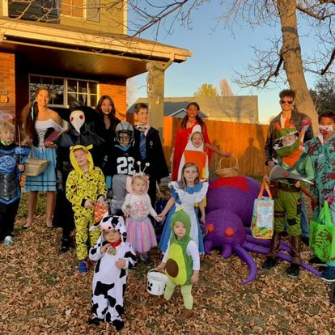
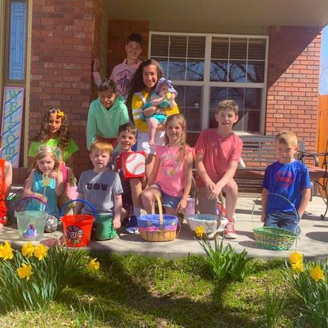
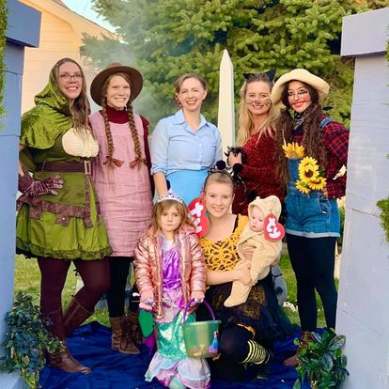
Holidays

Slide 8
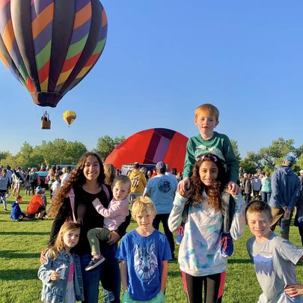
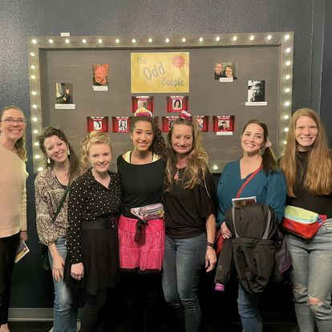
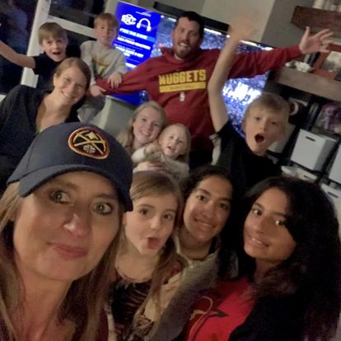
Town Events & Other Events

Slide 9
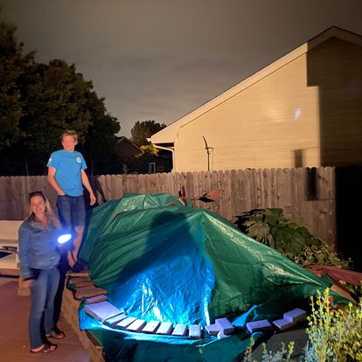
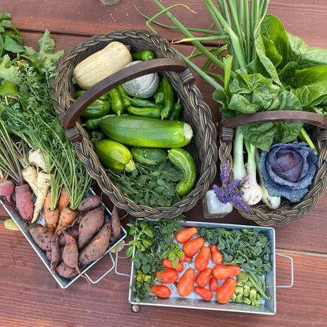
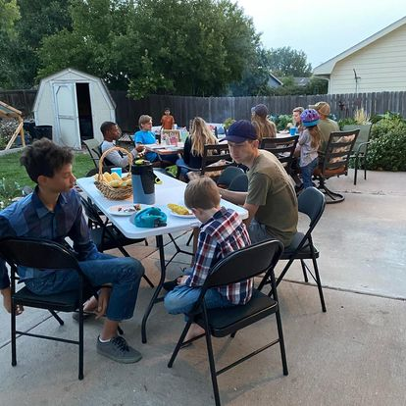
Share and Receive

Slide 10
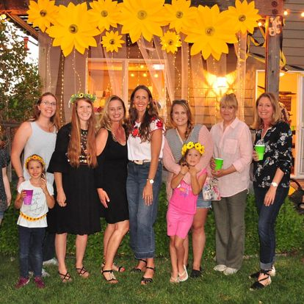
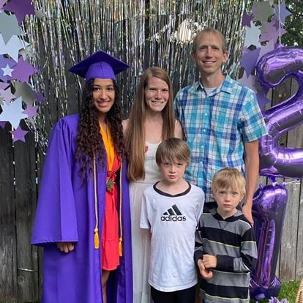
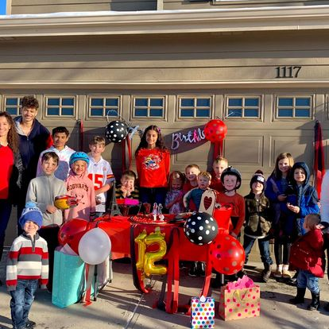
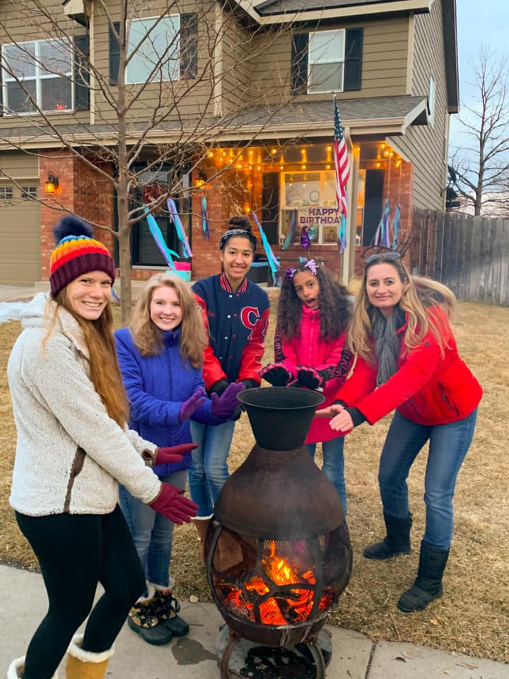
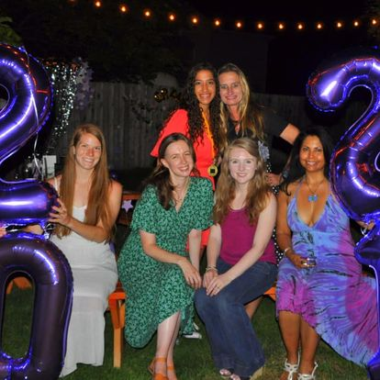
Birthdays & Graduations

Slide 11
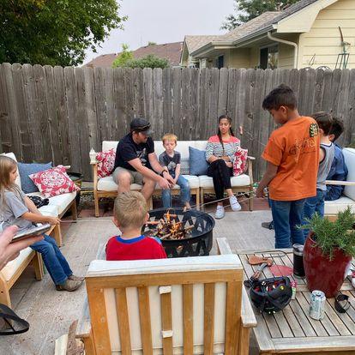
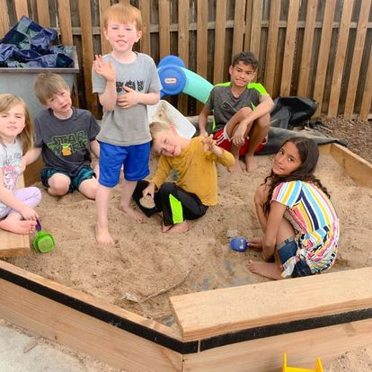
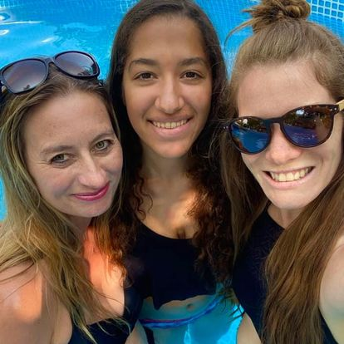
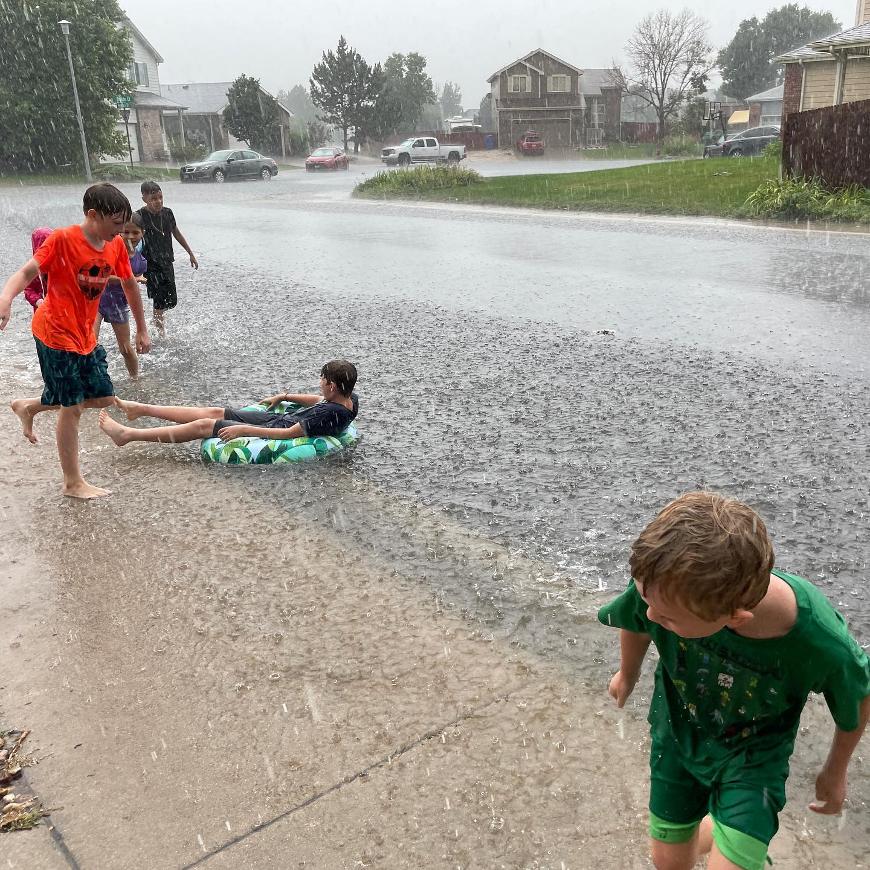
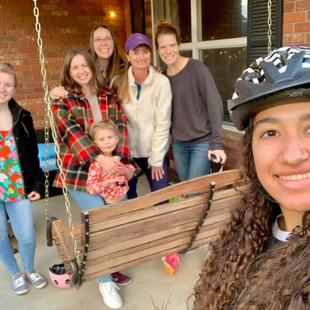
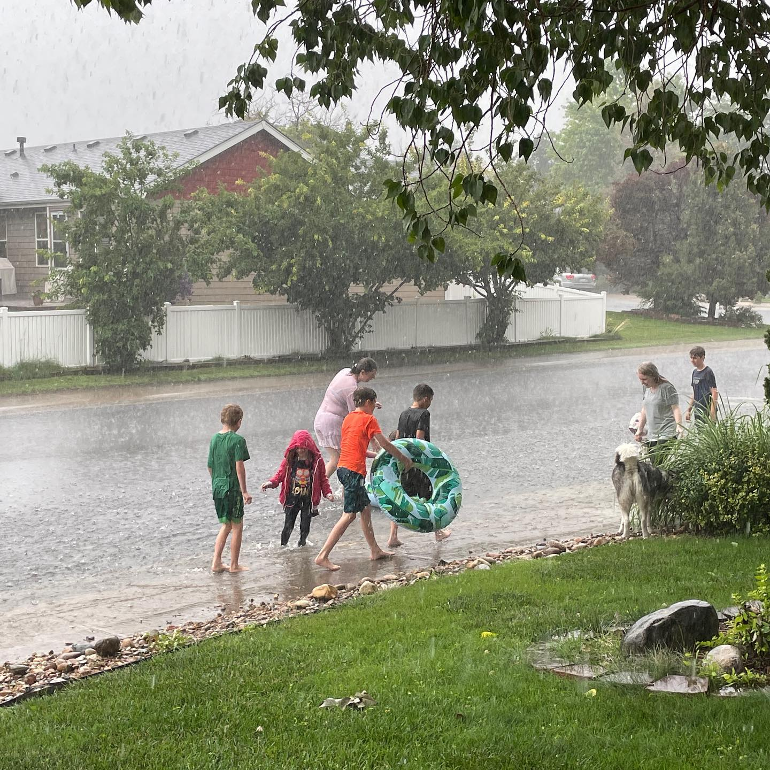
Backyard and Front Porches

Slide 12
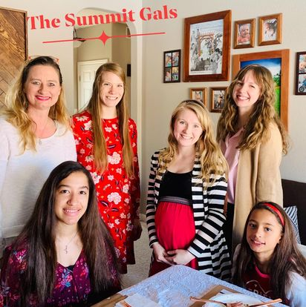
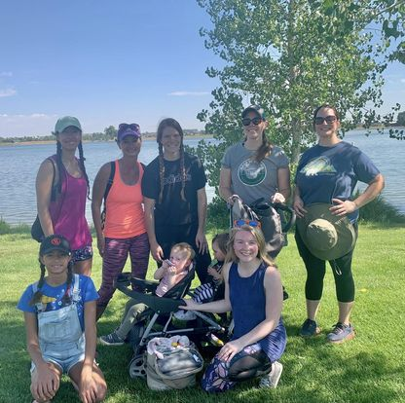
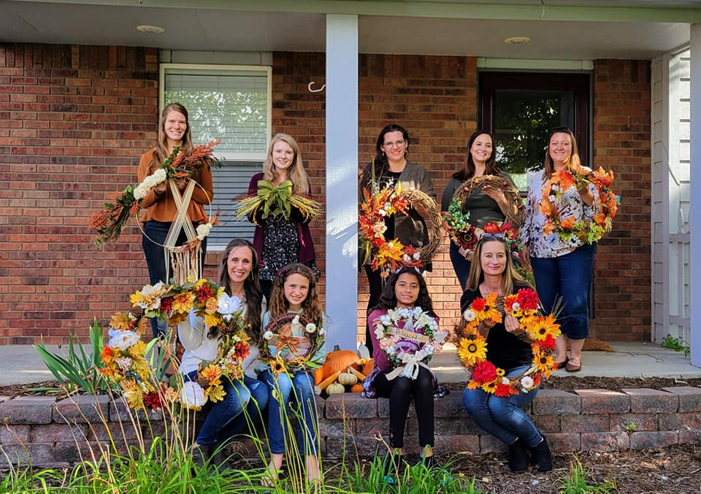
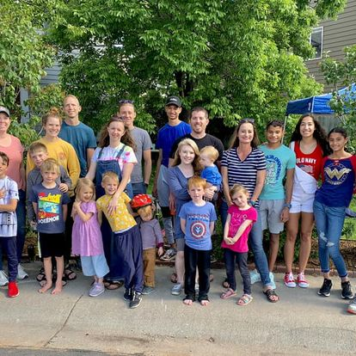
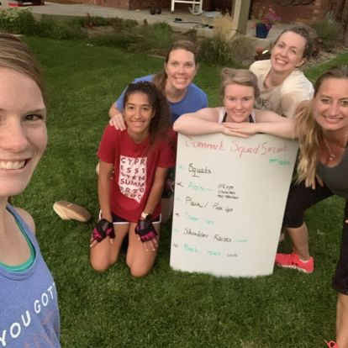
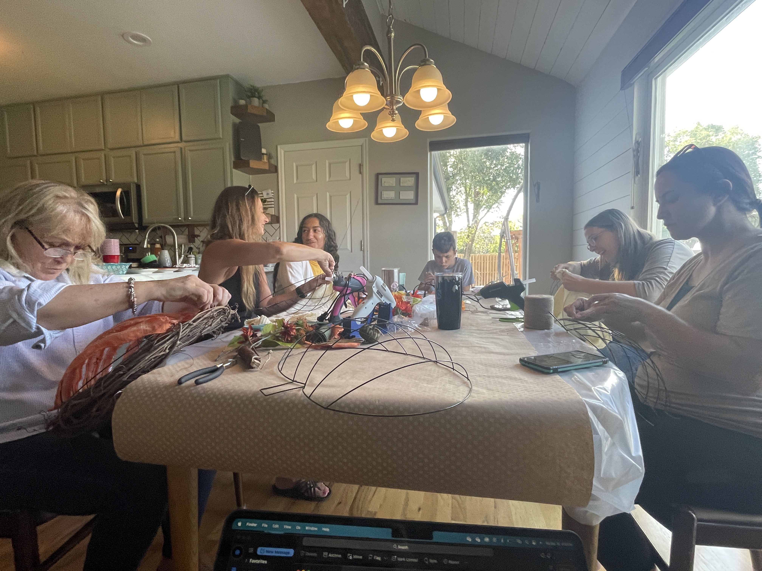
Create Parties & Get Togethers

Slide 13
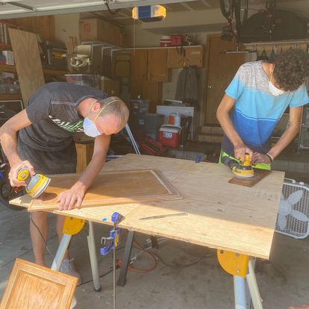
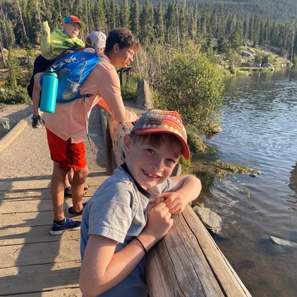
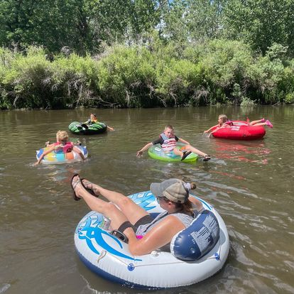
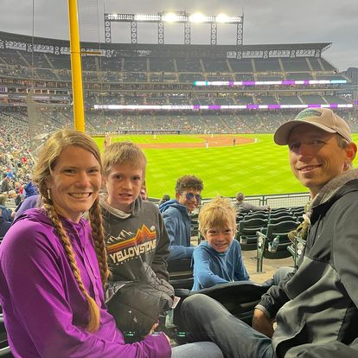
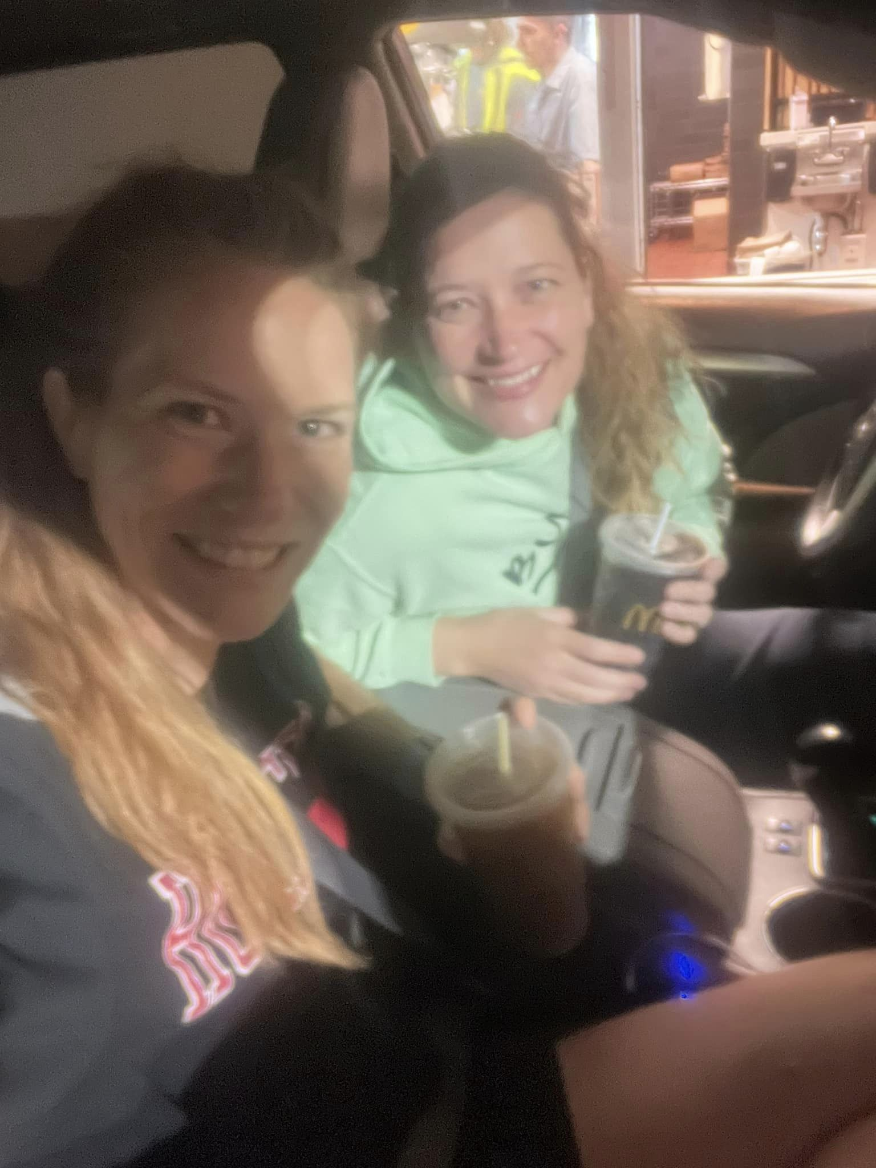
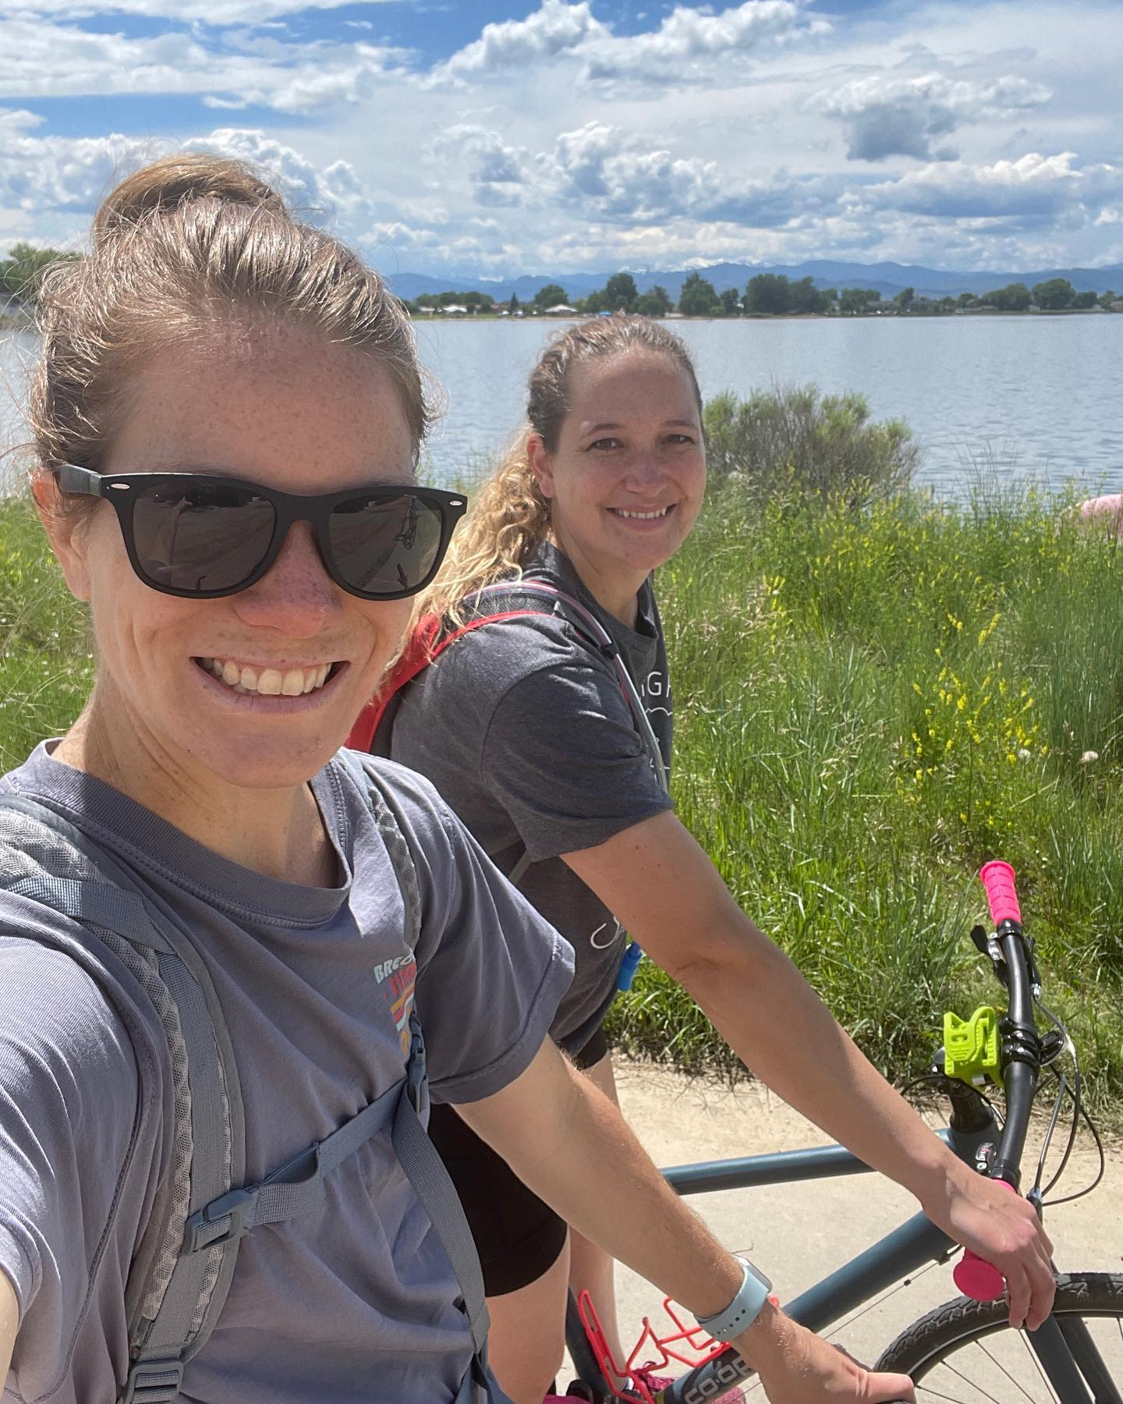
Invite someone – who’s around you?

Slide 14
How SERVE 6.8 supports churches and neighboring
Can be a trusted referral source if someone’s needs go beyond what you and your church can do
Create outreach systems for churches to focus on neighborhoods
Volunteering and discipleship
Want to learn to walk with people; come volunteer in Resource Centers
Creates Gospel encounters and opportunities
Supports churches with resources
Goal is to build systems down to a neighborhood level

