Slide 1
Lifespring Church
Poverty through a
Gospel Lens

Slide 2
4 Weeks – Topics Covered
Theology & Truth
Generational Poverty
Key Scriptural passages on Poverty
Scripture & Prayer in Care
Notes:
Ask people names and about them – what have they been involved with at Lifespring, how long have they been there
Give overview of who SERVE 6.8 is
The 4 different topics we’re going to cover over the next 4 weeks. All of Scripture is a story line of God’s creation, its fall and its redemption.
Within this story, we discover a lot about who humans are and who they were meant to be, this includes an understanding of poverty and the effects of the fall on humanity.
Poverty is a complex issue that we could talk about for much more than 4 hours, but this will be an overview that that specifically looks at what Scripture says about financial poverty and what our approach as Christmas should look like.

Slide 3
Lifespring Church
Week 1: Theology & Truth

Slide 4
Week 1
Opening Exercise – Values
Write down values you’ve learned from your parents and family
These could be ways of communicating, how you interact with people, how you work, physical items, etc
Now make 2 columns – one Good / One Bad
Sort your values into these two columns
How did you know which column to put different values in?
Notes:
For some of you, talking about more theoretical theology ideas may seem awfully boring and you can’t wait to get to more practical points of caring for those experiencing poverty, but stick with me. It’s important
that we first understand who God created man to be, how we’re impacted by the fall and God’s redemption if we want to see true transformative change and flourishing in other people’s lives
We are all taught different value sets, ideals, ways of viewing the world and behaving from our families, friends and life experiences. Values may differ based on our income level, our parents cultural background, our age and generation, and a whole lot of other influencing factors.
So how do we know what true values we should be striving for? This is where the truth of Scripture comes in, we need a compass in our life to know how to live and interpret what is happening to us and how to respond.

Slide 5
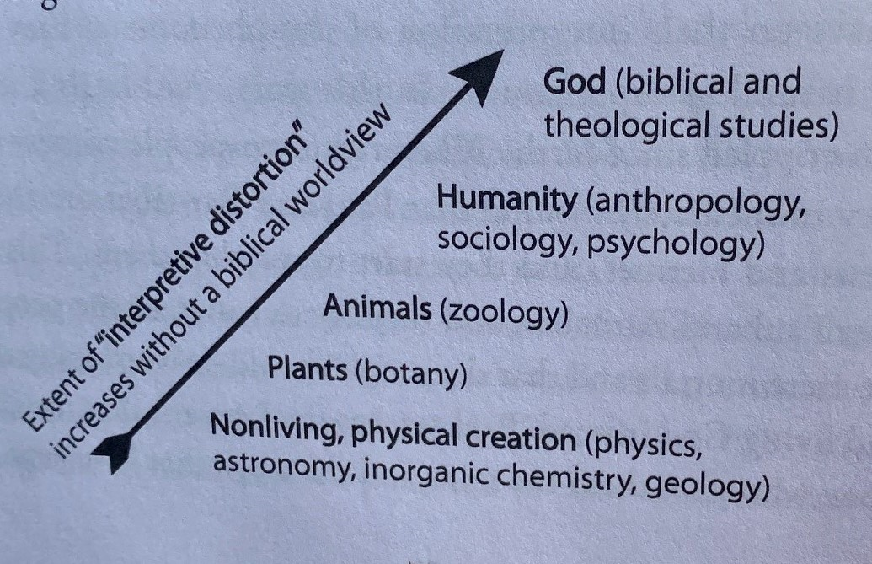
Authority of Scripture
Knowledge and Authority of the Word
High view of Scripture, do you believe it is infallible and true?
Do you believe its truth speaks to all areas of life?
General Revelation
God’s truth can and is revealed in science and psychology
How we interpret findings is based on our worldview. The closer an object gets to being like God, the greater chance we have of misunderstanding
Notes:
First, we must then accept that scripture is authoritative. If we want to minister to people and walk with people in poverty, we need to operate out of the values and worldview of Scripture and the understanding that it is true, authoritative and transforms us holistically – mind, body and spirit
Common grace is alive- we observe the world – psalm 33 and romans 1 – the world testifies to God – Ecc good and bad happen to everyone – called to steward (discover and cultivate creation)
Authoritative – mind body spirit – why its so important to get an accurate view of humanity, we are image bearers so it’s important we understand who we’re working with

Slide 6
Scripture on its Authority
Psalm 19
Romans 1:18-25
1 Corinthians 1:18-25
Hebrews 4:12
2 Timothy 3:16-17
John 14:17, 23-26
Isaiah 55:8-9
For the word of God is alive and active. Sharper than any double-edged sword, it penetrates even to dividing soul and spirit, joints and marrow; it judges the thoughts and attitudes of the heart.
Hebrews 4:12
Notes:
Some verses you can make note of

Slide 7
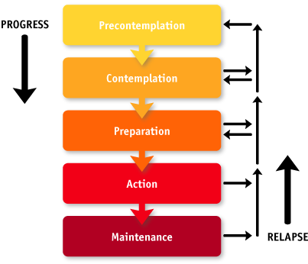
Gospel Transformation
How do people change?
Here are the standard stages of change
Involvement of the Holy Spirit
In Christianity, stages of change may look the same, but the how behind it changes
The Spirit convicts, enables, empowers, makes us new
This doesn’t mean that change doesn’t still have cycles for believers
Notes:
A foundational truth of what Scripture, is how we were an old creation and became new through Christ. 2 cor 5
¹ So Christ himself gave the apostles, the prophets, the evangelists, the pastors and teachers, ¹² to equip his people for works of service, so that the body of Christ may be built up ¹³ until we all reach unity in the faith and in the knowledge of the Son of God and become mature, attaining to the whole measure of the fullness of Christ.
¹⁴ Then we will no longer be infants, tossed back and forth by the waves, and blown here and there by every wind of teaching and by the cunning and craftiness of people in their deceitful scheming. ¹⁵ Instead, speaking the truth in love, we will grow to become in every respect the mature body of him who is the head, that is, Christ. ¹⁶ From him the whole body, joined and held together by every supporting ligament, grows and builds itself up in love, as each part does its work. Ephesians 4 – sanctifications and becoming mature
Our greatest hope should be that others experience the salvation and transformation that we ourselves and accepted through Christ
Let’s look next at how this transformative change impacts our relationship with self, others and creation

Slide 8
Titus 3:1-8
Remind the people to be subject to rulers and authorities, to be obedient, to be ready to do whatever is good, ² to slander no one, to be peaceable and considerate, and always to be gentle toward everyone. ³ At one time we too were foolish, disobedient, deceived and enslaved by all kinds of passions and pleasures. We lived in malice and envy, being hated and hating one another. ⁴ But when the kindness and love of God our Savior appeared, ⁵ he saved us, not because of righteous things we had done, but because of his mercy. He saved us through the washing of rebirth and renewal by the Holy Spirit, ⁶ whom he poured out on us generously through Jesus Christ our Savior, ⁷ so that, having been justified by his grace, we might become heirs having the hope of eternal life. ⁸ This is a trustworthy saying. And I want you to stress these things, so that those who have trusted in God may be careful to devote themselves to doing what is good. These things are excellent and profitable for everyone.

Slide 9
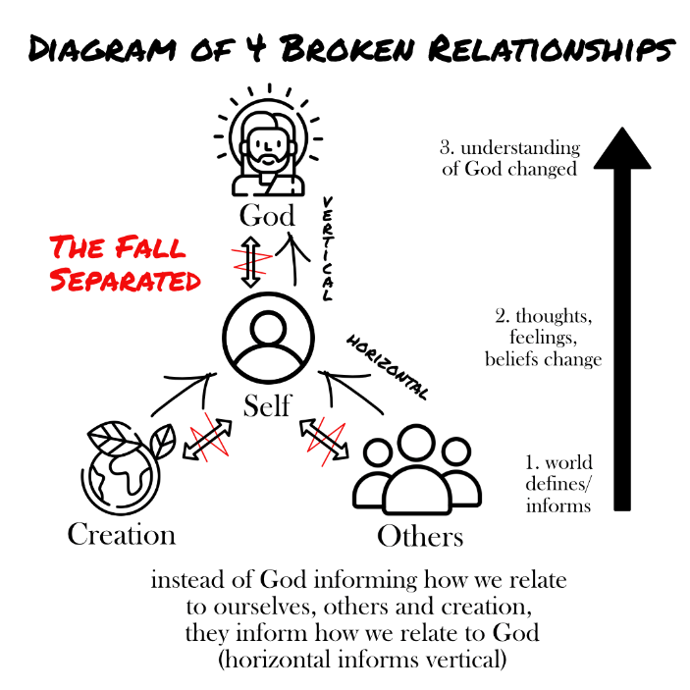
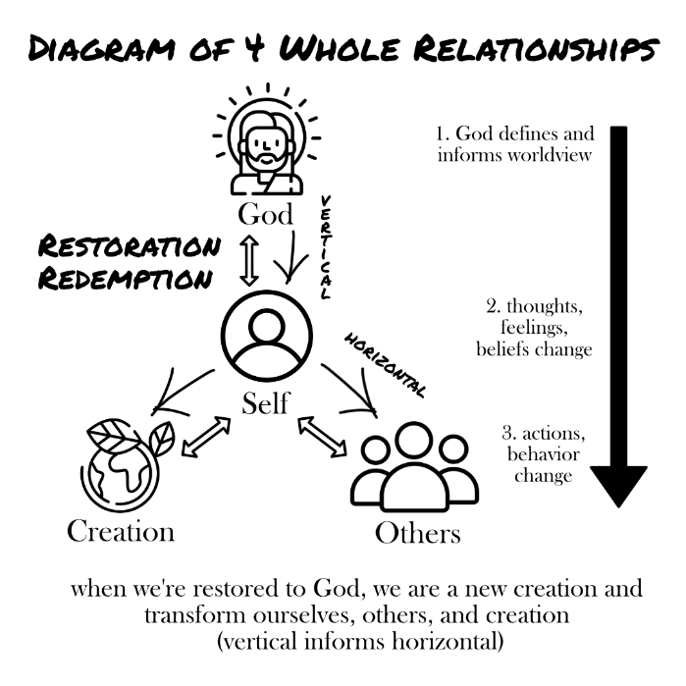
4 Foundational Relationships
Notes:
If you’ve read When Helping Hurts, then you will recognize the 4 relationships
The idea of these are that how people interact with their self, others and the rest of creation are impacted by their relationship with God. We must first look to healing our vertical relationship to see change in our horizontal relationships
In poverty, we see how all 4 relationships play out for people. Poverty is a complex impact on people caused by systems, individual choices, and choices of other people in their lives. Let’s look at case study to see how all these factors are at play in the life of someone experiencing poverty

Slide 10
Vignette
After reading the description of this individual’s life – identify ways they were impacted by the falls’ influence on their view of self, others, creation and God.
Will share observations together after and discuss
What did you observe with the 4 relationships?
What did you observe about the complexity of poverty?
Notes:
James (not real name) is approx. 60 years old and lives in the foothills of Las Vegas, NV. He’s been living with his wife off the grid on generational land in an RV where they have little contact with other people, no working plumbing and primarily live self-sustaining. They venture into town only to get necessities; have no friends or family nearby; and their primary income consists of different government benefits. Enter a fire that destroys the property and RV they were living in, forcing them to evacuate into Las Vegas for weeks to live in a shelter and then in a hotel. Now they are stranded in Las Vegas with no home to return to, no saved finances to rebuild, and they are waiting to know what government resources are available to them through FEMA . FEMA is trying to process thousands of claims and re-adjusting rules for proof of property for many living on inherited lands without deeds or titles. James is primarily sustained by donations of the community – paying for hotels from emergency disaster grants, food and hygiene items for community donations, staying in the Red Cross shelter and eating hot meals prepared by disaster response and church teams. Used to working most days, he gets bored quickly and decides he wants to volunteer at the shelter every day. James works hard every day at the shelter, mopping; making coffee; unloading donations etc. He himself still needs to visit the resources available to him so he takes breaks to visit other agencies around, he needs assistance filling out paperwork for rebuild permits as he struggles a bit with reading / writing and wants help interpreting documents. While he has a primarily happy personality, he quickly becomes annoyed with those who are “taking advantage of the system” and is frustrated with the long process of help and getting financial assistance. Many days he spends telling other shelter volunteers about who is abusing the help, who comes every day just to take stuff, and who wasn’t even impacted by the fire - his disdain of people taking advantage of help is clear and he is more than happy to help screen out those who aren’t fire victims but keeping coming back to the disaster resource center. Through all these interactions, he never expressed much interest in religion. He doesn’t express any Christian faith but also isn’t hostile to working with church members and is appreciative of the work they are doing. At the end of our 2 weeks together, he and his wife are still in Las Vegas waiting, volunteering and unsure what the future holds for them.

Slide 11
Lifespring Church
Week 2: Generational Poverty

Slide 12
Government Systems (Case Study follow up)
Government Responsibilities
Safety, Punish wrong – promote good (1 Peter 2:13-14; Romans 13)
1 Samuel 8:6-9
Our role with the Government
Government, Churches, and Families all have different roles
Government has more capacity to provide a safety net, but
Can’t move quickly, large scale policy, hard to account for individual needs (do the most good for the most people)

Slide 13
Generational Impact
What diseases run in your family?
What behaviors did you learn from your parents?
What did you learn about money from your parents?
Have you inherited any money from your parents / grandparents?
Have you been able to take advantage of your parent’s social connections?
What changes did you make to be different from your family?
The role models / parents form how we think and view the world and interact with it
Notes:
We may value individuality as a culture, but we’re formed by our families and we can’t think of our lives as completely independent and not impacted by the people around us. Just like the diseases that may run in our families, how we view the world and react can also be passed down to us

Slide 14
Biblical Passage – Generational Impact
⁻ Family is God’s creation to raise children, provide relational support, and train up future generations, but our relationships were impacted by the Fall
⁶ These commandments that I give you today are to be on your hearts. ⁷ Impress them on your children. Talk about them when you sit at home and when you walk along the road, when you lie down and when you get up. Deuteronomy 6:6-7
³⁰ for we are members of his body. ³¹ “For this reason a man will leave his father and mother and be united to his wife, and the two will become one flesh.”^{[c]} ³² This is a profound mystery—but I am talking about Christ and the church. Ephesians 5:30-32
Genesis 3
Notes:
God created the family as the main means to show his relationship with us, to provide us with supports and to train up future generations. He created an ideal family make up of father and mother to represent Christ and his Bride, the Church – our nuclear family is an example of the relationship of Christ and his Church. Many family correlations of how we should operate together and how family was created.
But we didn’t make it very long before the fall happened, God gave out the punishments, including discord between wives and husbands, painful childbirth, toiling away to produce life and food, etc. The next chapter we see jealousy strike between Cain and Abel, not to mention the first murder and another curse upon Cain and his work upon the land. While our families may contain less murder, the certainly are impact by the fallen nature of man. It certainly doesn’t seem like Cain learned what not to do from his parents, instead he seems to continue in their sin. We certainly can’t say families got less complicated as the story of Israelites continue to unfold.
This is all to say that we had a created family to teach us the ways of God and how to live and how to steward all of creation, but this ideal way of living was impacted by the fall. Now we can fully expect to see things like generational poverty, diseases, mental illness and more. We see these and much more passed through generations of Christ, just read some genealogies and think about all that was passed between his forefathers

Slide 15
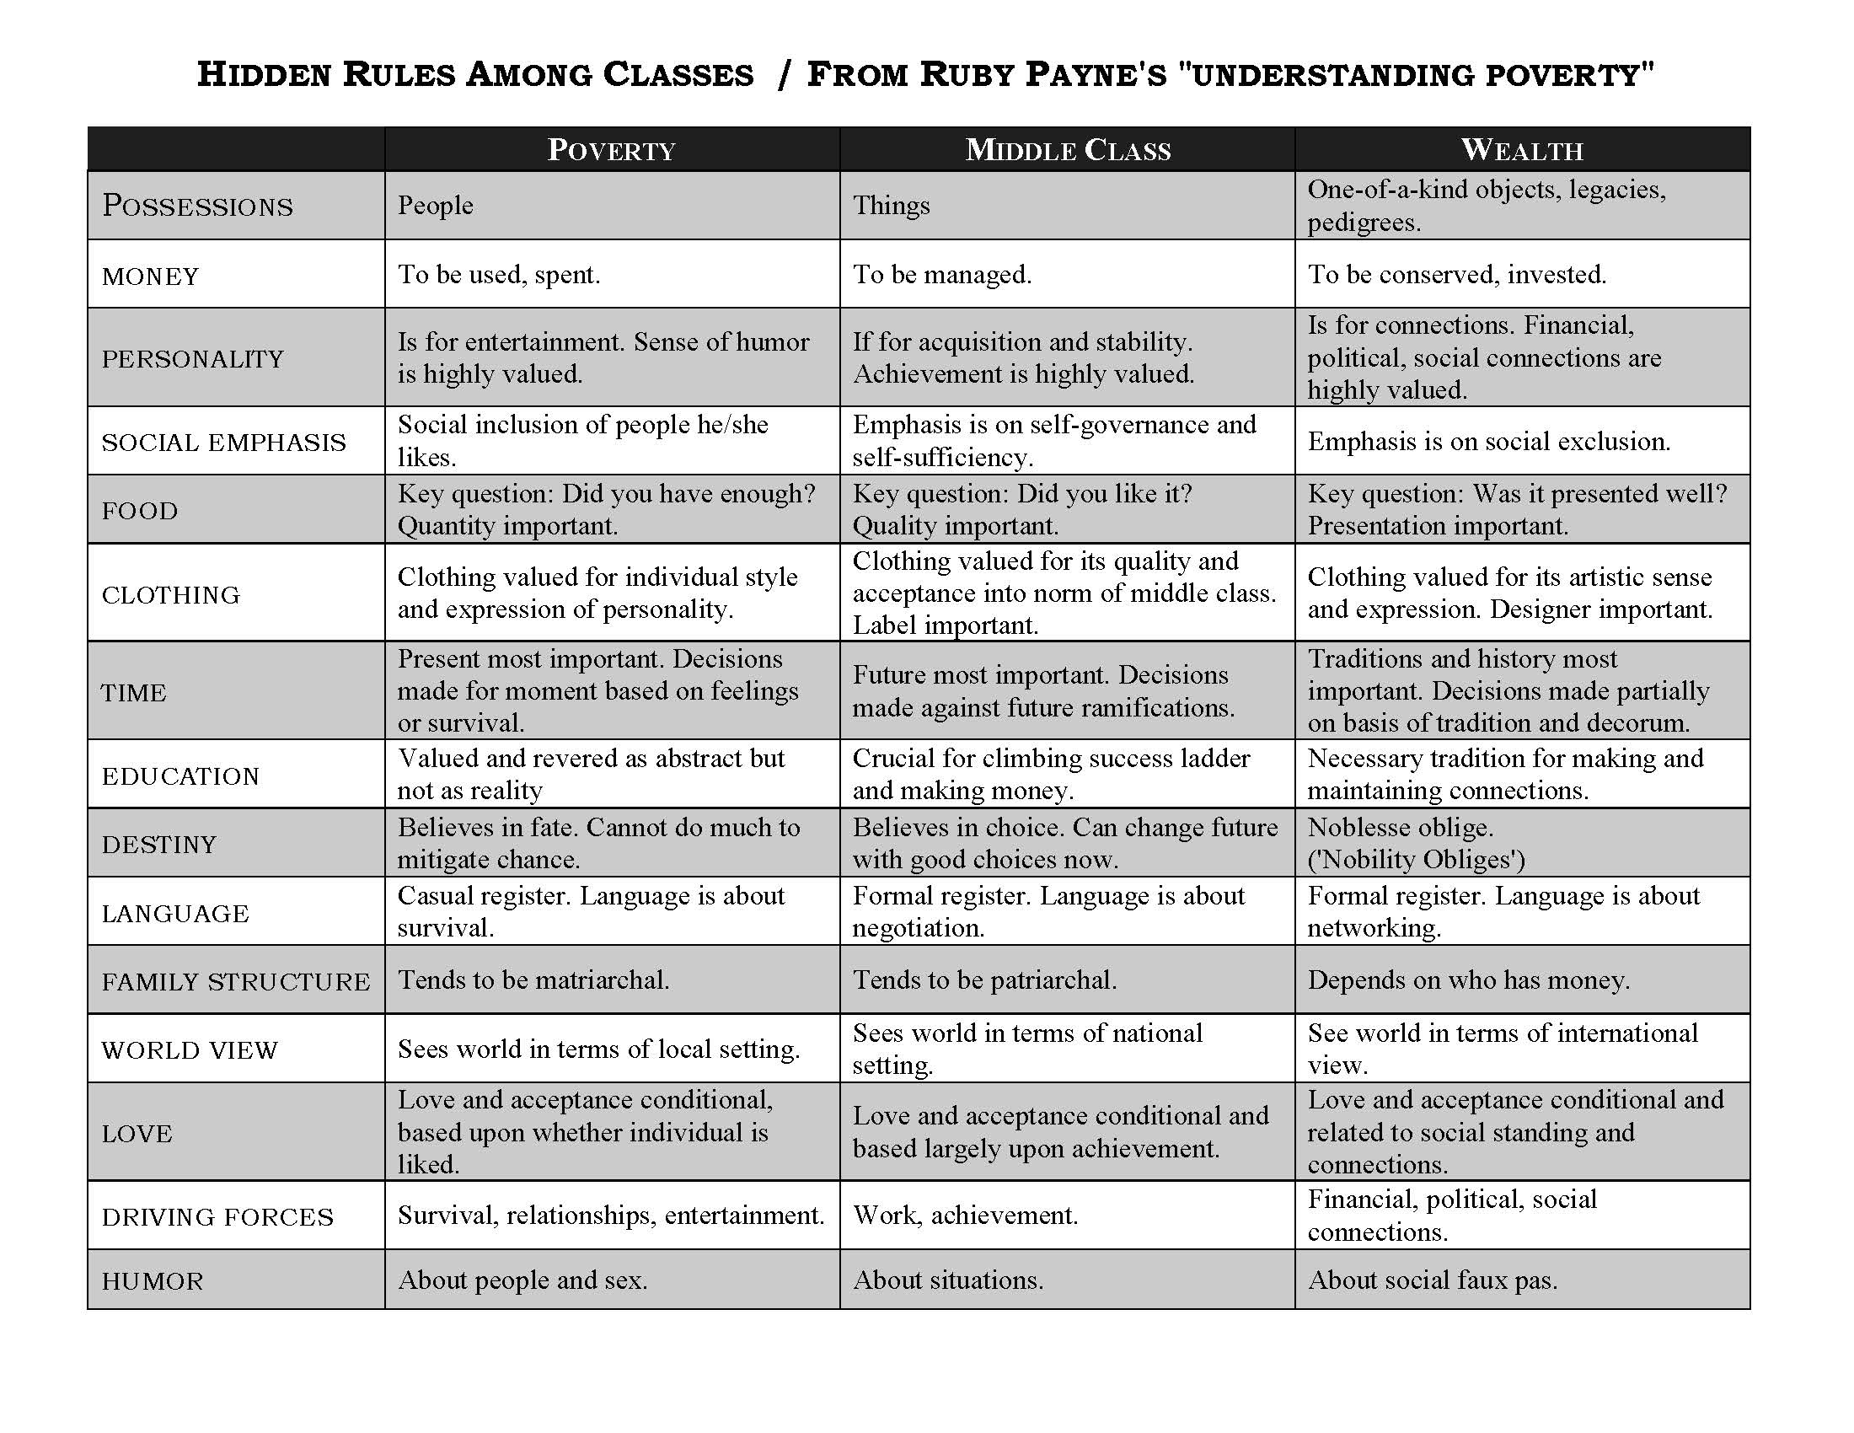
Values of Classes
Notes:
Moving past Scripture, now we see that a lot of what we inherit in our worldview can come from our financial position in society. These are of course broad categorizations, but generally how different classes view the world.
Now most of our going to be within the middle class column, but let’s look at the difference is value sets of those experiencing poverty. These are views and values that are passed down generationally and many of us likely don’t give them much thought. We just live our lives without thinking about the motives we’re operating out of. It’s important for us to give us thought to how other people behaviors are formed though.
We can be quick to look at the behaviors of those experiencing poverty and wonder why they make certain decision. Because they also are acting in a way that is guided by motivations, values and thoughts they’ve learned. Like we discussed last week, we all have been taught different values as good or bad, but what matters is that we seek to live the true values that Christ teaches us. Scripture does have things to say about caring for each other, what families should look like, how to manage money, etc. It’s helpful to honestly assess what of our class values we deem superior because we view them as ”good” and what values do we have in our class that may not be God honoring? We’d find that each class probably has values that honor God and ones that don’t. All people need to be re-oriented to God to experience true flourishing.

Slide 16
Values Continued The Least, The Last, The Lost – Poverty in the UK by Mez McConnell
Housing Scheme
I know which churches have food banks, etc
I don’t trust authority figures
I don’t have a bank account
I know how the benefits system works
I know how to move out of a house in 3 hours
I can talk to someone with the TV on full blast know how to survive without electricity or gas
Money is used immediately
Decision made feelings based
Communication: direct, informal, story based
Hospitality: open door
Middle Class
I know how to get my children into a good school
I understand life insurance, savings and pensions
I discuss university options with my children
I have savings in my bank account
If someone visits, I turn off the TV
I encourage my children to do read / homework
I call police if there is a disturbance
Money is to be managed
Decisions consider long – term consequences
Communication: indirect, formal, ordered
Hospitality: strong boundaries

Slide 17
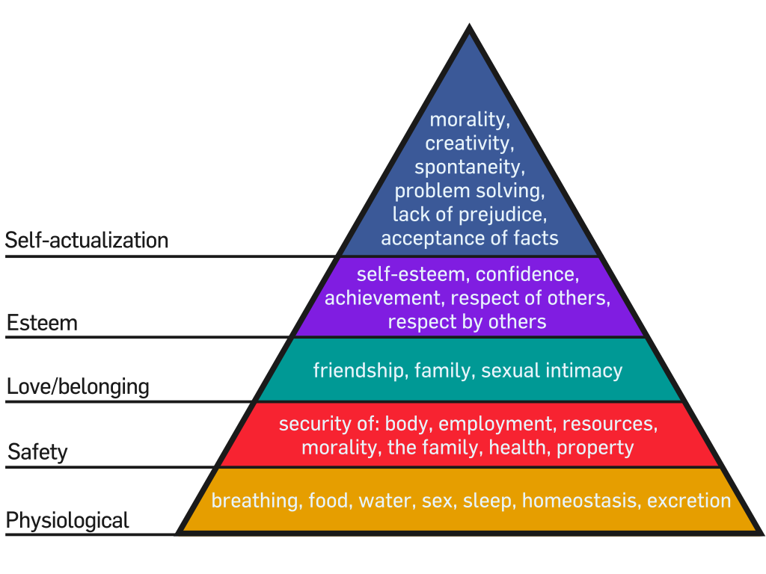
Learned Hopelessness
For those experiencing generational poverty, they are also experiencing generational hopelessness
No future planning, survival mode, this is all there is to life
We all need a cheerleader – did you have a mentor that helped you see more in yourself?
For many of us, this is Jesus - where many people saw fishermen, etc he saw they future leaders of the Church
Likewise, we need to look for what people have working for them, acknowledge and build on it
Maslow’s Hierarchy of Needs
Notes:
Christ – healings physical but also pointed to future hope and didn’t leave people there

Slide 18
What does Poverty look like locally?
Poverty is diverse in Larimer County: transplants, generational, immigrants, refugees, all have different worldviews and barriers in poverty
Can even look different in Northern Colorado vs Denver or other regions of the United States
80% AMI for family of 4 - $85,000
11% poverty rate in 2017
Livable wage (2018), 2 adults & 2 children: $17.84/hr
Repeated concerns: housing, gaining or keeping employment, “the cliff”, child-care costs, reliable transportation
Notes:
Transplant – moved to Fort Collins and away from family, often have jobs fall through or social supports to rely on
Generational – not as many people who’ve been in the same community for generations, but still more who experience worldviews of generational poverty – does tend to be more Caucasian americans
Immigration – Hispanic culture also experience poverty, older generations may have language or legality barriers, but have a strong sense of community and support for each other
Refugees / Migrants – have added culture shock, traveling with little, language and legal battles that may last year and put them in limbo

Slide 19
Lifespring Outreaches
Discussion
What have you observed through outreaches and mission events you’ve participated in with Lifespring?
What are cultural difference you’ve observed?

Slide 20
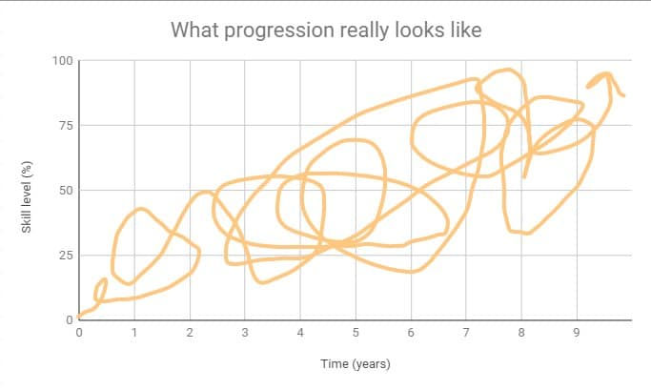

Slide 21
Generational Poverty & Goal Setting
Goal: holistic flourishing and re-oriented to God
Body, mind, spirit
What then are values that are honoring of God and which ones aren’t?
Assess your assumptions – will it be harmful to let the other person work their order of goals? Could you instead ask questions to help them think critically about their decisions?
God values free will
Notes:
Why did Christ come? Because we couldn’t follow rules, in Romans we read consistently that we do what we don’t want to. We’re helpless sinners incapable of following the ways of living or rules that God gave us. Such an impossible tasks that God sent his only son to save us.
We then need to take a similar approach with people, just teaching people rules or telling them how they ”should” be living is ineffective. We can however, become facilitators of change. Working to help people leave financial poverty is a long, tedious task. It requires relationships, getting to know people at their motives, their dreams, their goals and understanding how they are being impacted by the 4 relationships. We may have limited impact on system, beyond exercising our right to vote for policies we deem helpful – but we can do a lot in one on one relationships to help show people the change Christ can make in their life now and eternally. This takes time, patience and true relationship.

Slide 22
Poverty & Goal Setting
Think back to stages of change, when we are working with people experiencing financial poverty, we first must work with them to identify what needs to be changed in their life
Ask questions, help highlight patterns, get feedback and learn more about their motivations & values, ask questions about what their goals are
Once changes needed have been identified, pick appropriate interventions
Basic budgeting vs Financial Peace, healing family ties, getting an affordable degree, joining one community or church group, lending social capital
Identify what other supports are needed to on their journey: rental assistance, filling out applications, interview practice, help paying for a class, counseling, government benefits

Slide 23
Goal Setting Activity
Think of a New Years goal or any goal you’ve had or thought about setting
Mock interview
Ask questions to uncover the goal
Ask questions about what their motivation is behind this goal
Talk through attainable steps to achieve this goal

Slide 24
Lifespring Church
Week 3: Key Scripture on Poverty
Notes:
What is your definition of poverty?

Slide 25
Poverty Definition in Scripture
³⁵ Jesus went through all the towns and villages, teaching in their synagogues, proclaiming the good news of the kingdom and healing every disease and sickness. ³⁶ When he saw the crowds, he had compassion on them, because they were harassed and helpless, like sheep without a shepherd: Matthew 9:35-36
Hebrew & Greek words for poverty have different meanings
- most vulnerable & oppressed in society, lack of materials / possessions, poor health / education, poor quality of life, a poverty of spirit

Slide 26
Poverty Definitions in Scripture
Causes
Oppression
3 Types
Precarious (paycheck to paycheck)
Abject (completely dependent)
Spiritually (all classes impacted)
No-Fault Disaster
Laziness / Self-Inflicted
Gospel Poverty

Slide 27
Key Principles
Moral Proximity / Concentric Circles of Care
Gleaning
- Voluntary Principle
Partiality
Lending & Interest
Relational Discipleship
Scripture in Care

Slide 28
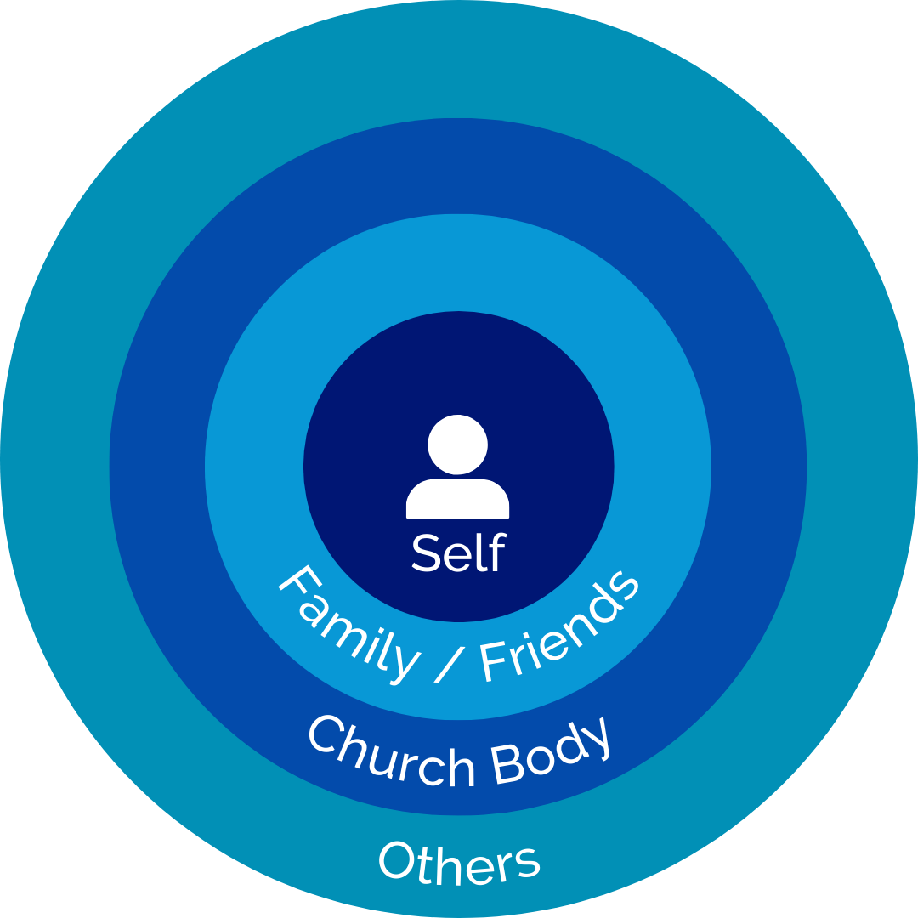
Moral Proximity concentric circles of care
1. take care of family
2. take care of fellow believers
3. take care of community
Gal 6:9-10, 1 Timothy 5, Acts 6:1-7, 2 Corinthians 8:1-9
Can be in terms of geography, but is primarily outlined in terms of closeness of relationship
1 Timothy 5:8, 1 John 3:17

Slide 29
Gleaning
The principle that God asks farmers to leave food at the edges of their fields for the poor or foreigner to come gather
Deuteronomy 24:19-22, Leviticus 19:9-10.
Corporate command requiring sacrifice and work for both the giver / receiver
Ruth, example of gleaning
Empowerment Models
Seeking investment to allow participation in solutions and creativity to use God-given gifts and skills
A model used after crisis has been resolved (relief, recovery, development)

Slide 30
Jubilee & Voluntary Participation
The goal is heart change to be a generous and a cheerful giver – not forced redistribution
Leviticus 25 (25:10-17)
Jubilee was also a time to observe the Sabbath, rely on the Lord, and help neighbors continue to provide for their selves
2 Corinthians 8:1-15
Notes:
¹⁰ Consecrate the fiftieth year and proclaim liberty throughout the land to all its inhabitants. It shall be a jubilee for you; each of you is to return to your family property and to your own clan. ¹¹ The fiftieth year shall be a jubilee for you; do not sow and do not reap what grows of itself or harvest the untended vines. ¹² For it is a jubilee and is to be holy for you; eat only what is taken directly from the fields. ¹³ “‘In this Year of Jubilee everyone is to return to their own property. ⁴ “‘If you sell land to any of your own people or buy land from them, do not take advantage of each other. ¹⁵ You are to buy from your own people on the basis of the number of years since the Jubilee. And they are to sell to you on the basis of the number of years left for harvesting crops. ¹⁶ When the years are many, you are to increase the price, and when the years are few, you are to decrease the price, because what is really being sold to you is the number of crops. ¹⁷ Do not take advantage of each other, but fear your God. I am the Lord your God

Slide 31
Partiality
Not to treat anyone with favor due to their economic status
Leviticus 19:15, James 2:1-9
Not making decisions based on what people can do for you

Slide 32
Lending, Interest, Fair Scales
If you lend money to any of my people with you who is poor, you shall not be like a moneylender to him, and you shall not exact interest from him. Exodus 22:25
It is well with the man who deals generously and lends; who conducts his affairs with justice. Psalm 112:5
You shall do no wrong in judgment, in measurement of weight, or capacity. You shall have just balances, just weights, a just ephah, and a just hin; I am the Lord your God, who brought you out from the land of Egypt. Leviticus 19:35-36
Nehemiah 5:1-15 & Amos 8:3-7 vs Acts 4:32-35 & 2 Corinthians 8:8-15
Notes:
Concept – Micah 6, Isaiah 58, Amos, other prophets spoke a lot about treating the poor fairly, not taking advantage of poor
Nehemiah 5:1-15 & Amos 8:3-7 vs Acts 4:32-35 & 2 Corinthians 8:8-15

Slide 33
Reflection Questions
What are some key concepts you’re observing in these poverty principles?
What is the why behind these commands?
What heart change is God looking for?
How can you apply these concepts and principles?

Slide 34
Lifespring Church
Week 4: Scripture and Prayer

Slide 35
Mission of Church
Evangelize & Disciple, the Great Commission
Can’t forget about the mission of the church when caring for others
“love your neighbor has yourself”
We can all practice these principles
Notes:
This applies to peoples mental, emotional and spiritual needs as well. Difference in biblical care is we believe people are made by God and for God, so we take a evangelistic and discipleship bend to our care, our goal is to bring people back to God and walk with them on their journey to be more like him

Slide 36
Relational Discipleship counseling in care
People have emotional, social and psychological needs
Most people participate in organic and informal counseling. This is a great place for all believers to participate in care and neighboring
Looks like coworkers, friends, neighbors, church attenders, your small group, community members seeking help from your church
Your level of counseling will vary depending on circumstances
one time / sporadic care, ongoing / consistent relational care, sometimes you’ll need to refer to a pastor our counselor
No matter if it’s one time or ongoing, you can still use Biblical principles of care
Notes:
- Two examples: volunteer working with gentleman who lost job and doesn’t want to be on government benefits but is on the cliff and is experiencing situational depression or ministering in small group: member with non believing trans sister who is struggling with finding a job and their identity; neighbor who doesn’t know what to do with her son who misbehaves and she feels at her end; neighbor who just separated from her boyfriend and is figuring out custody with her daughters;

Slide 37
Scripture & Gospel Intersection
Scripture doesn’t have to be used as a quick fix to people’s problems
Examples, responding to someone with an anxiety by citing Philippians 4:6 and not providing other counseling or listening
We can use Scripture to point back to truths and provide direction to other’s lives
We can use Scripture passages to help people see how truths can apply to their lives and see how the Bible relates to what they are going through
We can listen to what people are saying and pay attention to key areas where you can point people back to Scripture
Think about people’s life stories in the meta-narrative story of Scripture (creation, fall, redemption, restoration)
Notes:
Listen for feelings: guilt, shame, fear, - do they sound depressed, anxious?

Slide 38
Christ Follower?
Your approach won’t be the same
You can’t expect someone who believes different than you to respond the same way or accept the truths of Scripture. You can still point them back to these truths and use a Biblically informed approach. There may be more of an evangelism bend involved here
For Christ followers, counseling will have much more discipleship. We are calling our brothers and sisters to God
¹² What business is it of mine to judge those outside the church? Are you not to judge those inside? ¹³ God will judge those outside. 1 Corinthians 5:12-13
Prayer
One of the easiest ways to start sharing Scriptural truths with believers and nonbelievers
It’s a way to encourage the person you’re speaking with, a way to invite the Holy Spirit into your conversation, and communicates that you care enough to take time to pray – You’re modeling correct views and communication with God

Slide 39
Neighboring examples and strategy
Community pot lucks
Neighborhood easter egg hunt
Deliver holiday treat baskets
Sports watching parties
Offer to rake leaves or shovel someone else’s driveway
Go on neighborhood walks (and invite someone to go with)
Neighborhood movie night
Birthday porch parties
Share garden vegetables
Offer to start a neighborhood text group or get contact information from neighbors
Offer to help with yard work or pet sitting
Do you have examples?

Slide 40
3 Guiding Questions
Where have you been
What brought you here
Where do you want to go
You probably won’t ask the questions in these words, but this is the mindset to drive questions to figure out what’s going on, where the problem arose, and what solution you’re working towards

Slide 41
Conversation Skills
OARS
Open ended questions, affirmations, reflective listening, summarizing
Probing Questions – building on open ended questions
Active listening, don’t be so ready to respond that you don’t listen
People want to know you care and don’t see them as a project
Don’t get caught up thinking it is your primary role to fix people, you are an ambassador for Christ, God is the ultimate change maker and healer – rely on His strength not ours
Let the Holy Spirit lead you, pray before you meet and remember He is in the room with you as you minister.

Slide 42
Stories of Church Success
Sharing stories of the group to encourage us for the future
Do you have stories of when the local church or members of the church cared well for you?
Do you have examples of building relationships with your neighbors?
Have you seen relationships and care happening well at Resource Center Pop Ups or other LifeSpring Outreaches?
Notes:
If no examples: share about how Faith works well with people, Iglesia Pentecostal Unida and their outreaches in Fort Morgan, Overland Church and their outreaches and starting the ESL class, partnership of Antioch and Legacy Church to care for migrant population, story of Mike and his care

Slide 43
Key Takeaways
All these lessons are a filter
Point hasn’t been to teach you what to think but how to think
You can and should neighbor where you are
Challenge yourself to meet and understand people who are different than yourself
A culture of care includes understanding the culture of others (ie generational poverty)
See people holistically (mind, body, spirit)
Everyone has inherent dignity and worth, has gifts and skills
Understand the role of the local church and your individual call within the church body
We discussed poverty principles like: moral proximity, partiality, not collecting interest, gleaning, voluntary principle, the 4 relationships, and authority of scripture
Notes:
Filter – every case and situation is different, so need to be able to filter information

Slide 44
Books for Continued Learning
For the Least of These by Anne Bradley and Art Lindsley
The Least, The Last, The Lost by Mez McConnell
Church in Hard Place by Mez McConnell and Mike McKinley
What is the Mission Church by Kevin DeYoung
Loving your Community: Proven Practices for Community Based Outreach by Stephen Viars
Side by Side: Walking With Others in Wisdom and Love by Ed Welch
The Church as a Culture of Care by Dale Johnson
Gospel Fluency by Jeff Vanderstelt

